Slide 1


Slide 2
Nuno Miguel Pinto Lopes Dinis Santos
Combining games and motion detection to encourage physical activity: A full-stack approach
Dissertação no âmbito do Mestrado em Engenharia Eletrotécnica e de Computadores orientada pelo Professor Paulo Jorge Carvalho Menezes e apresentada Departamento de Engenharia Eletrotécnica e de Computadores da Universidade de Coimbra.
Mês de 2025

Slide 3

The motivation:
Society’s is becoming increasingly sedentary. Most people do not have good exercising habits and it’s reflecting on the overall health of the population. This is a matter that has been well-known for a while, with a few articles, some from this department, which already identified it as a problem and tried to contribute to solutions.
Those solutions are to try to motivate people to perform tedious tasks by inserting a fun factor in them.
However, even after several studies and prototypes were made, none gave birth to a real project, which can be used to tackle this need. Although the main objective of this dissertation is motivating students to exercise, it holds a hidden one. To show that real projects, not prototypes, which have real impact on people and can help society, are possible to be made from this department.

Slide 4
Our contribution:
This dissertation plans on tackling this issue by creating a complete ecosystem, consisting of a Unity game (Aquatic Mysteries plus a proxy program), a website and an application. It is focused on motivating students from the University to be more physically active.
By taking advantage of a motion-based game, hence motivating exercise, the student will shift its attention from the burden of exercise, to enjoying the game.
With this project, the students can register in a website, have their data saved in a database, and start playing the game to try and win rewards.
The objective is to have several instances of the game running in specific areas of the university.

Slide 5
Our project:
GAME – Aquatic Mysteries was the game developed to keep the player entertained while performing exercise.
PROXY AND CAMERA – Since Unity does not support motion-based input data, a program had to be developed which could gather motion information and send it to Unity.
APPLICATION – The Super User application was the app developed to keep track of players, challenges, winners and create challenges.
FRONTEND: Blazor project which is running in misteriosaquaticos.pt website, allowing players to register.
BACKEND: An API + database which handles all data coming from frontend, Unity and SU application.
FRONTEND
PROXY
WEBCAM
BACKEND
GAME
Aquatic Mysteries
APPLICATION
Super User

Slide 6
Aquatic Mysteries game:
The objective of the game is to complete the exploration of all zones and get all rare items hidden in each zone except the starting safe zone.
While in game, players can navigate wherever they please, however, certain zones require a more upgraded vehicle to be explored. If a player ventures to a zone where they’re vehicle is not prepared, a vehicle failure will occur, spawning the player back in the starting zone.
More advanced zones have more valuable fish which increases the coins and credits earned. Exploring advanced zones allows the player to collect coins faster to unlock other modules and puts him at an advantage in coin and credit type challenges.

Slide 7

Game trailer

Slide 8
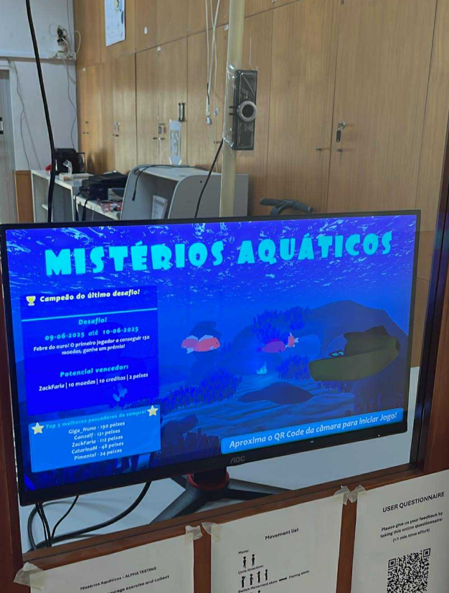
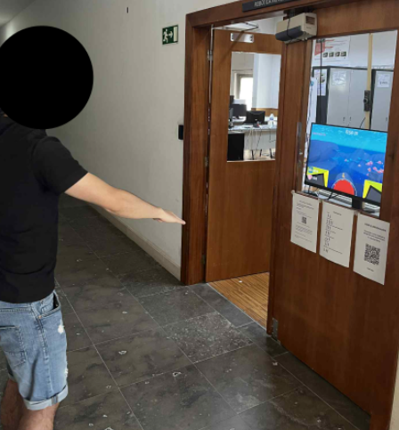
The setup:
To be able to have an instance of Aquatic Mysteries running in a computer, the following is required:
Computer (game is optimized, meaning it doesn’t need to have a strong GPU to be able to run)
Webcam
Internet connection
Aquatic Mysteries installed in the machine (an installer was created for easy installation)

Slide 9
Our biggest challenges:
The biggest challenge is not development! It’s people!
Exercising is only effective if it’s part of our routine, meaning that one session of 10 minutes won’t have any effect in the long run. This issue is highly tied together with the game. If a game is not fun, or doesn’t have the sufficient motivation to be played, players will simply leave it.
Knowing that the gaming market is highly competitive and players shifting focus faster from one game to another, some considerations had to be taken to ensure retention. This meant:
Game had to have meaningful progression (this excludes simple games like endless runners)
Game needs to be complex enough to engage users to play
Game needs to be visually appealing
Game had to be free of bugs
Finding innovative ways to motivate players (challenges + updates)
Even with these in mind, it is not enough to be sure the game will be successful. It is impossible to know if a game will be successful or not. We can only increase our chances.

Slide 10
How to create a good game:
A question that every game developer should ask himself: “Would I play my game at its current state?”
It is very important that, before the game goes public, the developer feels confident enough about the game. An unfinished game will have a negative impact on the audience, and given the current market of the gaming industry, one negative experience can be sufficient for people to never play your game again.
Therefore, it is crucial that developers follow good practices for when creating games. These practices include:
Bug free
Optimized
Fun
Sense of progression
Rewards
Achievements
Competitive factor
Visually appealing
Good audio
Balanced
Feedback

Slide 11
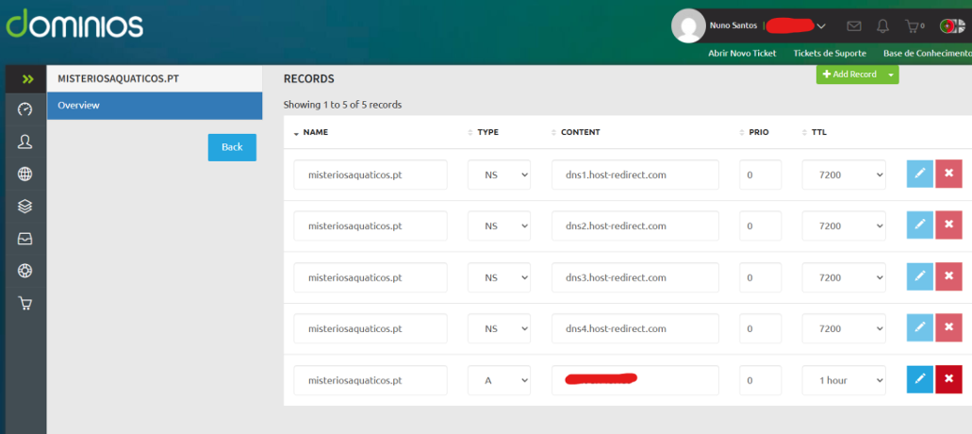
Frontend:
The website was made using Blazor, a Microsoft framework that allows developers to build web applications using C# and .NET. It is prepared to accommodate for several screen sizes (mobile devices and PC).
The project consists of three main pages:
Registration.razor (main page where users can fill information and click create account)
SuccessPage.razor (a success page informing the user that an account was created, displaying the QR)
GetQRCode.razor (a page dedicated to get the QR code)
This blazor instance is being hosted in https://misteriosaquaticos.pt, a domain bought that replaces the server IP address for a more intuitive entry point for users.

Slide 12
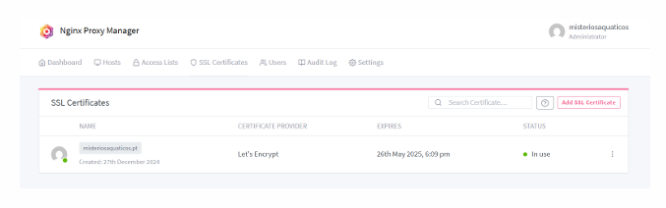
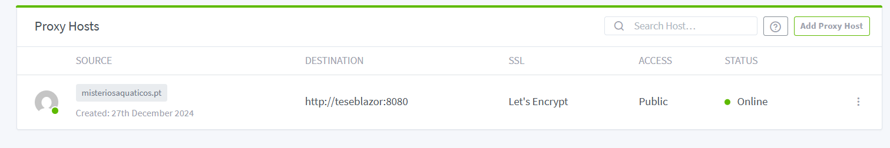
Frontend:
To have a secure connection (https), Nginx proxy manager was used.
Nginx integrates “Let’s Encrypt”, which issues an SSL certificate to secure websites and validate the domain ownership.
It gives a more professional and secure look and prevents trust warnings when accessing the website.

Slide 13
Frontend:
The registration page contains input validation for student ID and nick name. Since both are mandatory, and the student ID is exactly 10 digits, the validations for the input are:
Student ID not empty
Student ID exactly 10 digits
Nick name not empty
Nick name with max 10 digits (accommodate to leaderboards in game menu)
If the initial input is valid, an HTTP request will be made to the API register endpoint. This request (POST) holds the student data needed to register a player.
Once the request reaches the endpoint, another validation is in place to check if there is a user already registered with the given student ID. The following line:
Is responsible for such validation.
If the result is successful, the player will be registered.

Slide 14
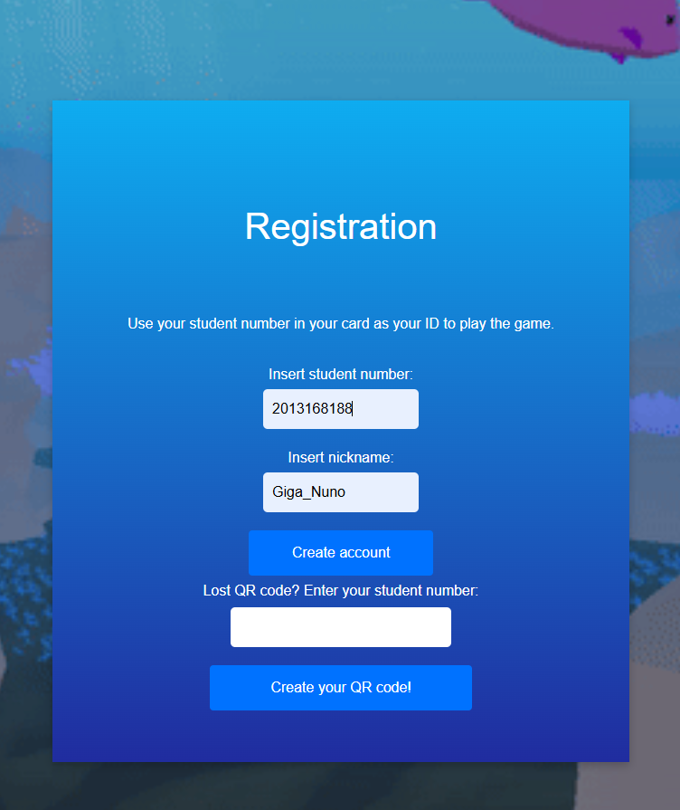
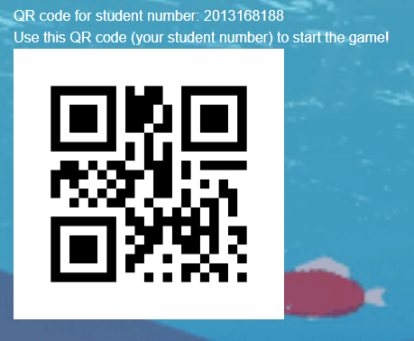
User registration process:
Player registration was designed to be quick and simple. Players just need to visit misteriosaquaticos.pt, fill in their student ID and chose a nickname.
Once the players clicks the “Create account” button, the frontend will call an endpoint in the API which will handle the creation of the account.
Once registration process is complete, meaning no validation errors occurred, the player is given a QR code which is needed to start the game with its data.

Slide 15
API:
The API functions as the brain of the frontend, Unity and Super User application communication. It is responsible to handle the endpoint calls and, consequently, the database alterations to keep all data updated.
Frontend communicates with the API for:
- Player registration
Unity communicates with the API for:
Getting player/challenge data
Posting/Updating player data
Check win conditions
Super User application communicates with the API for:
Getting player and challenges data
Creating/Ending/Modifying challenges

Slide 16
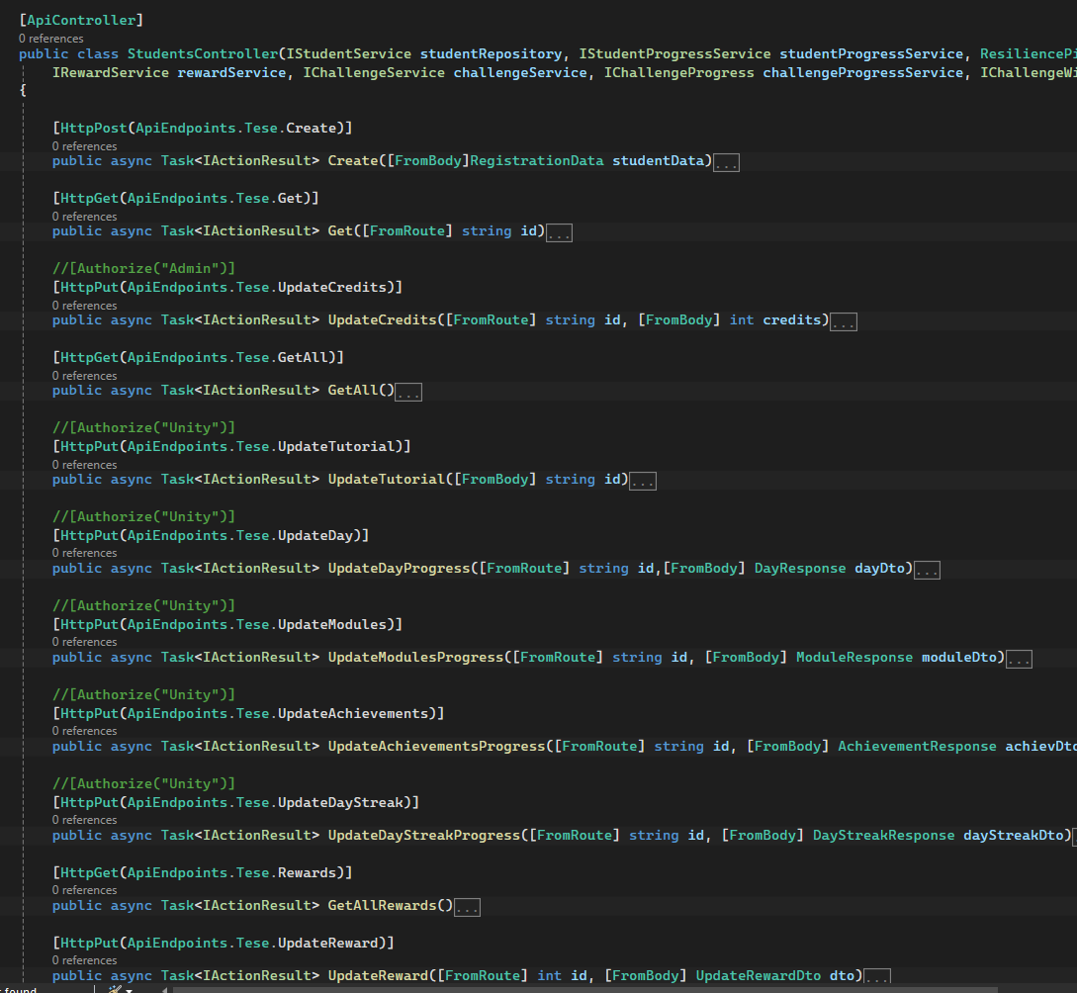
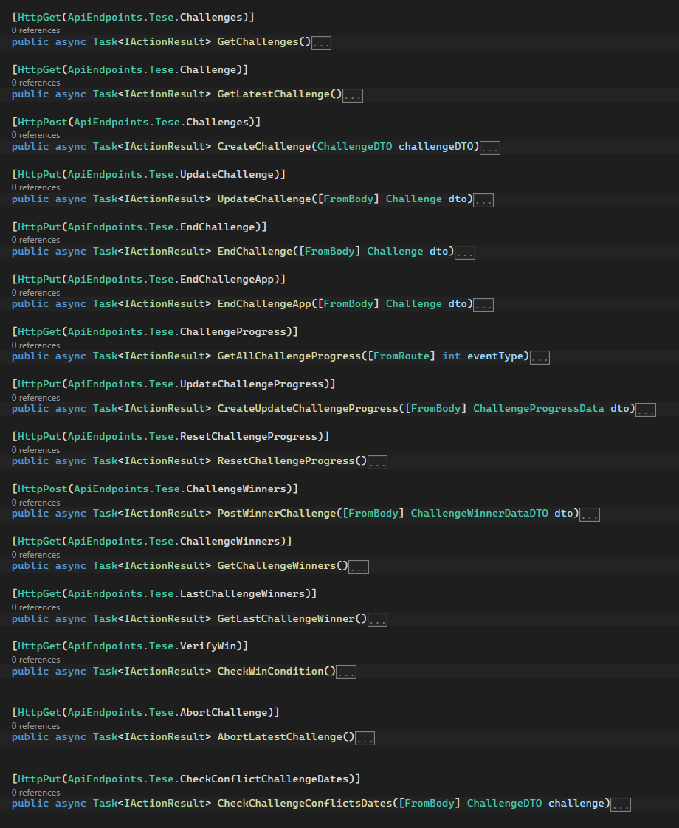

Slide 17
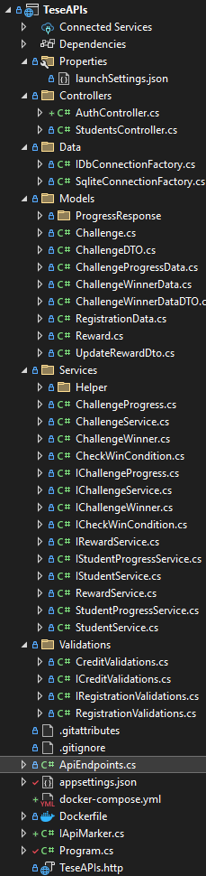

Slide 18
Proxy:
Unity does not support motion-based input data, meaning a proxy program had to be developed to enable that communication. Although this proxy holds more functionality, the main objective is for gameplay.
How is the data sent between the two:
Proxy creates a socket communication and act as server
Unity connects to this socket
Communication between the two is now possible.
How proxy captures movement data:
A camera is needed to record the person
OpenCV captures the video and gets each frame information
OpenCV process each frame and change it to accommodate to MediaPipe (AI library for human pose estimation)
MediaPipe applies AI pose estimation to capture human joint position
Joint values are extracted
How proxy sends data to Unity:
Helper methods calculate movement patters (ie. Squatting, arm lift, T-Pose, Arm direction pose)
Variables are changed accordingly to the patterns recognized
Data is serialized and sent to Unity through local socket

Slide 19
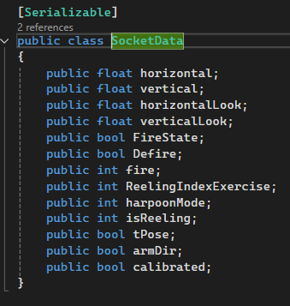
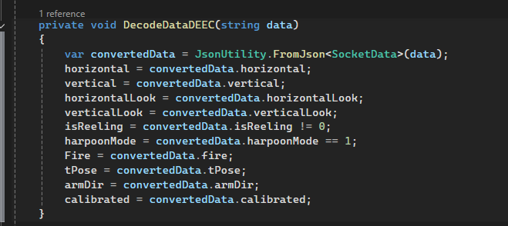
Unity receiving data:
In Unity, a script had to be developed to connect to the proxy program.
Once connected, it would constantly receive or send data depending on the state it is.
IF main menu => send “mm” to proxy
ELSE => receive data and deserialize it

Slide 20
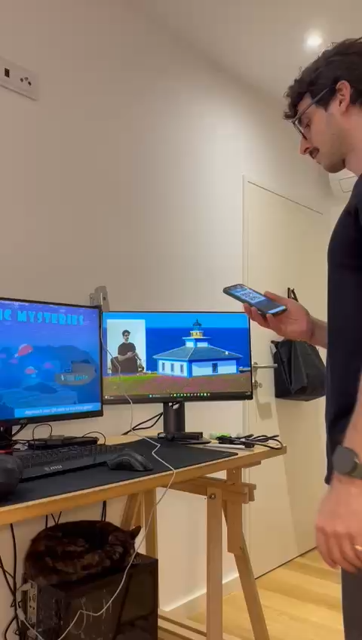
Entering the game:
Aquatic Mysteries is constantly running in a computer. The menu screen clearly informs the player to point its QR code (given at registration) to the camera.
While in main menu, the proxy is constantly trying to read the QR code and loading the game data.
If the data is loaded correctly, a loading bar will appear informing the state of the loading.

Slide 21
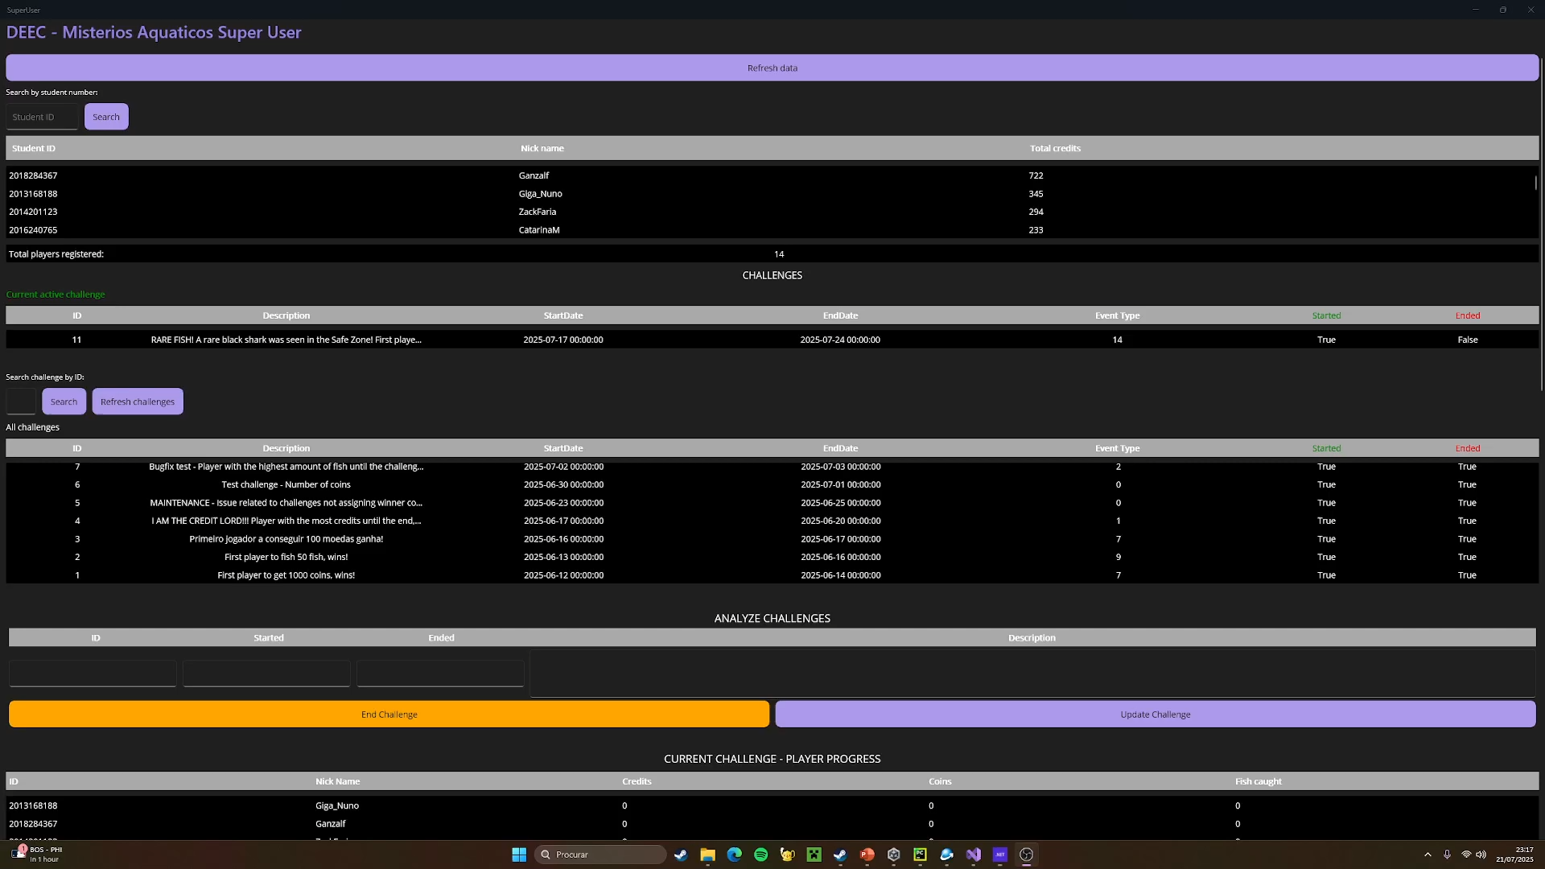
Super User Application:
The SU application allows a responsible staff member to track player data, past challenge winners, create challenges and modify challenges.

Slide 22
Challenges:
Having a more complex game was not enough. While testing the project, it was noticeable that without rewards, students would not keep playing, therefore, a reward-based gameplay was created.
The final decision was to create challenges. Challenges are the main factor for player retention and will reward the player who won the latest challenge.
There are a fifteen different challenges that can be created through the Super User application, enabling a diverse way of players to win and keep engaged. With these different challenges, players must pick of what they think the best strategy is to win.

Slide 23
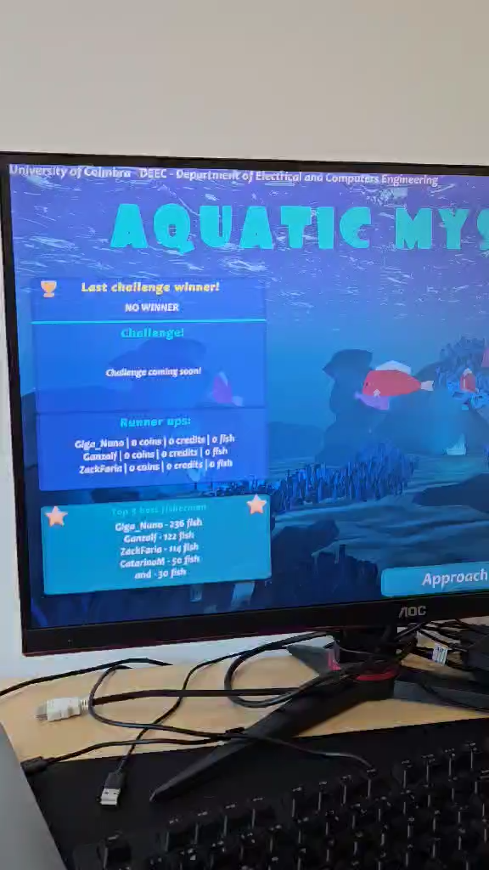
Creating a challenge:

Slide 24
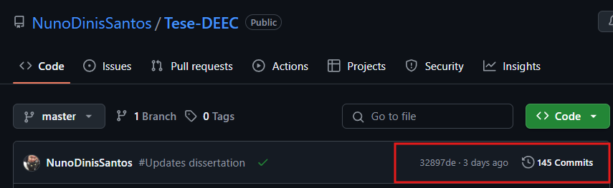
Faster deployment:
Being able to build and deploy the code faster is essential for productivity.
To automate the process of building and deploying the code (frontend + backend), a YAML configuration file was created in GitActions to handle the process, alongside creation of a Dockerhub account where the images of the projects are stored. Watchtower, a container created in the server, constantly watches every 30 seconds for updates of those images. If a difference is found, it shuts the current running instances, build new ones based on the new images and runs the containers once again.
Before using GitActions the process to release code was the following:
Change the code and commit to GitHub (no changes besides keep track of version)
Copy new .dlls to the server
Create images through dockerfile with command: docker build –t <imageName> <dockerFile>
Shut down previous containers with command: docker rm <containerIdOrName>
Create docker containers with the command: docker run –d –name <imageName> <containerName>
Every change the code suffered, to update the instance running, the previous process had to be made.
Why automate the process was a good idea?
Because:

Slide 25
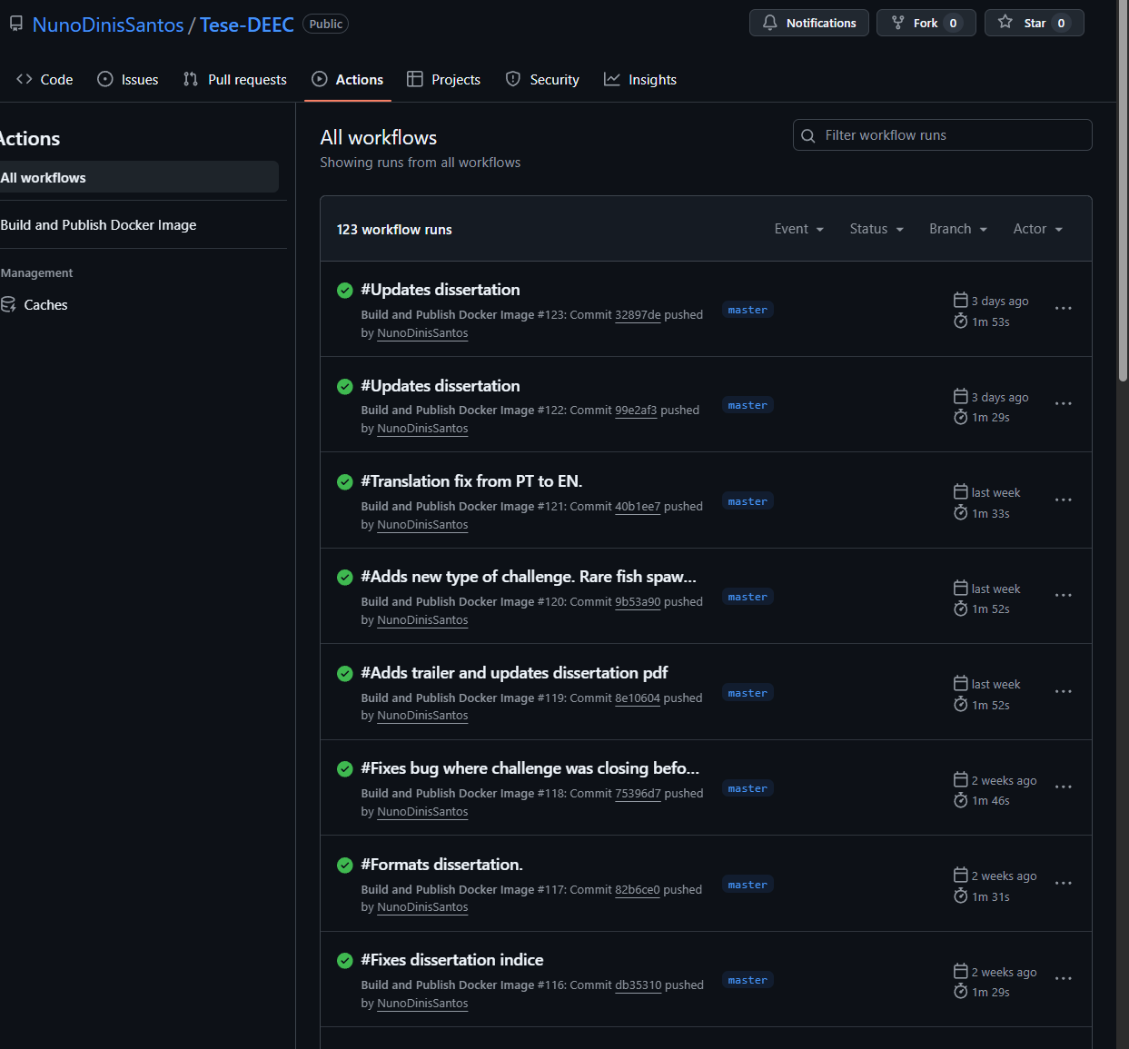
Faster deployment:
After applying faster deployment:
Commit code and wait a minute.
Done

Slide 26
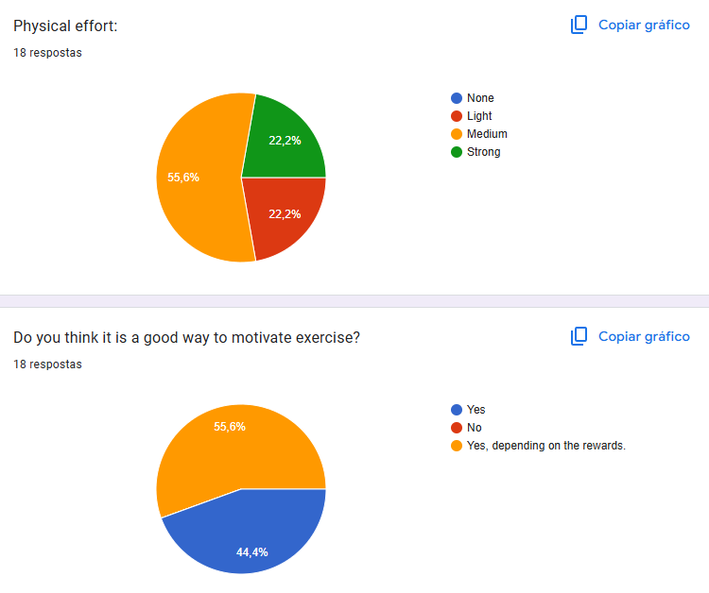
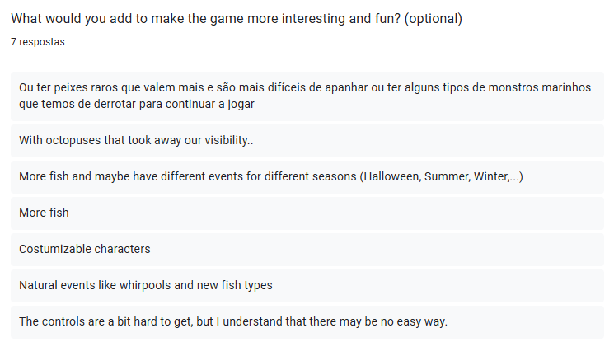
First results:
Majority of students felt that this was a good way to motivate exercise, however, there’s a high probability that the motivation is only tied to the rewards and challenges.
Majority of students believed that 10 minutes of gameplay was moderate to heavy physical effort.

Slide 27
Next steps:
Developer recommendation:
Migrate everything to University servers
New domain
Acquire more assets (fish, fauna, etc) to populate scene and have new fish to catch
Add more challenge types (departments competing against each other)
Add new movement types to Unity and Python
Add danger factor (?) -> maybe do a study beforehand

Slide 28
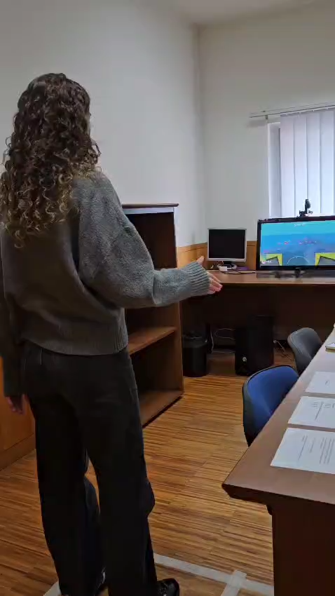
Gameplay demo:

